Slide 1
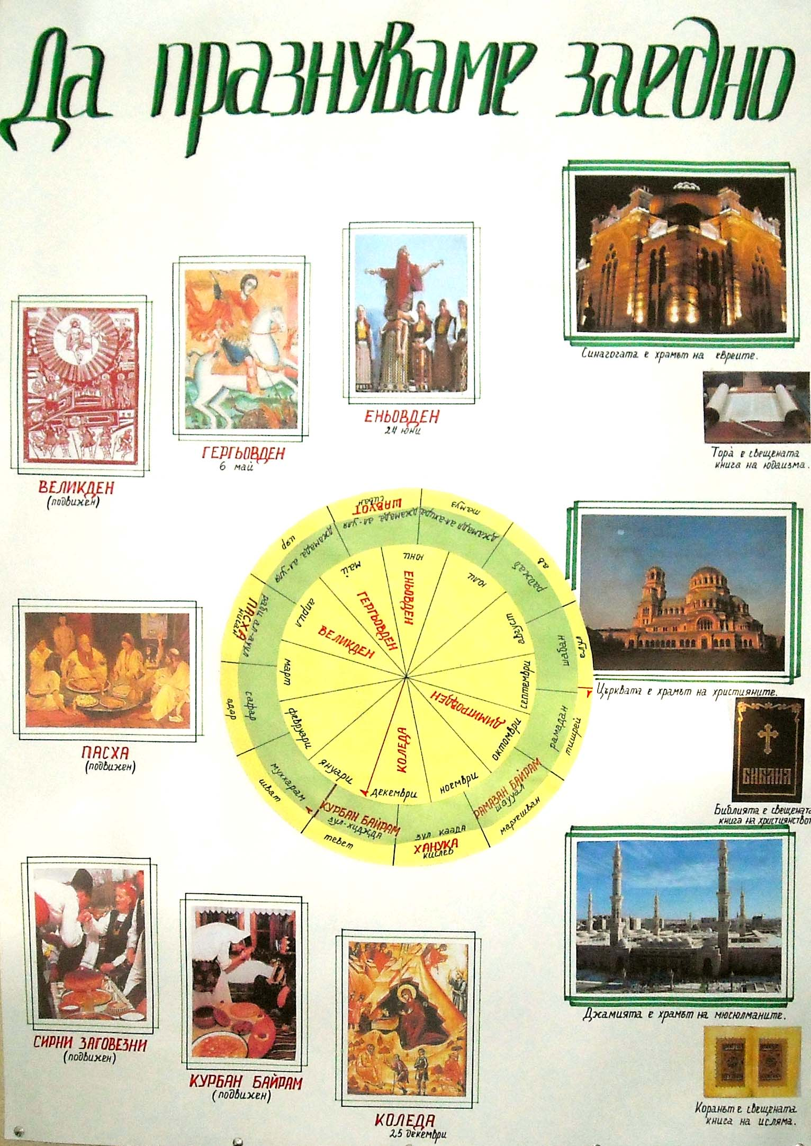
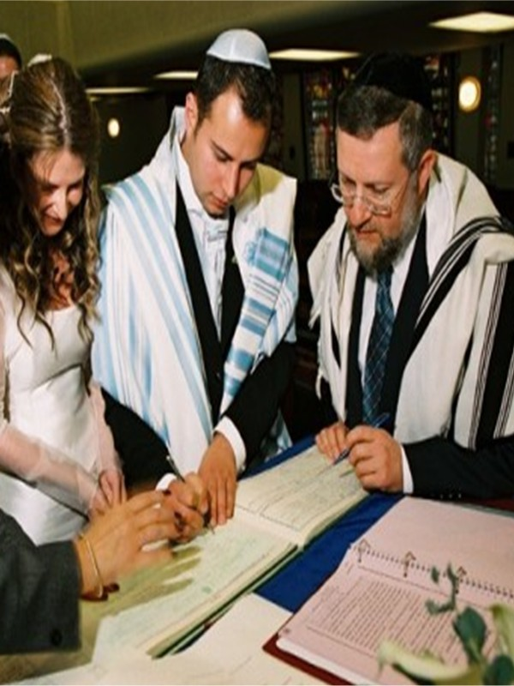
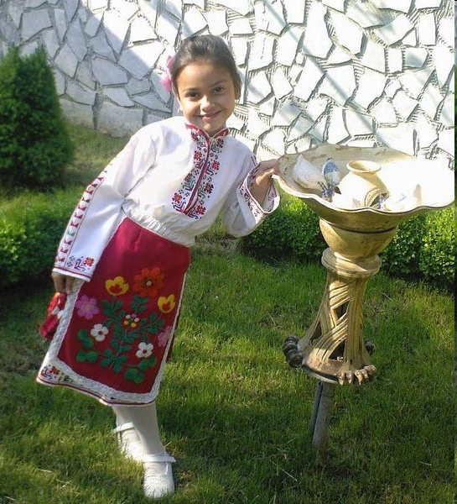
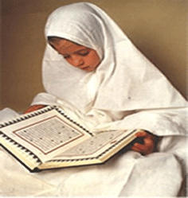
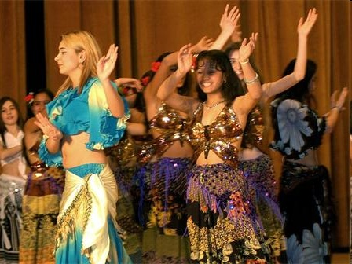
People of different faiths live in here
THE MOST IMPORTANT IS NOT RELIGION THEY PROFESS.
MOST VALUABLE IS TO SHARE LOVE AND UNDERSTANDING !
JEWS
CHRISTIAN
ARMENIANS
ROMA
MUSLIMS

Slide 2
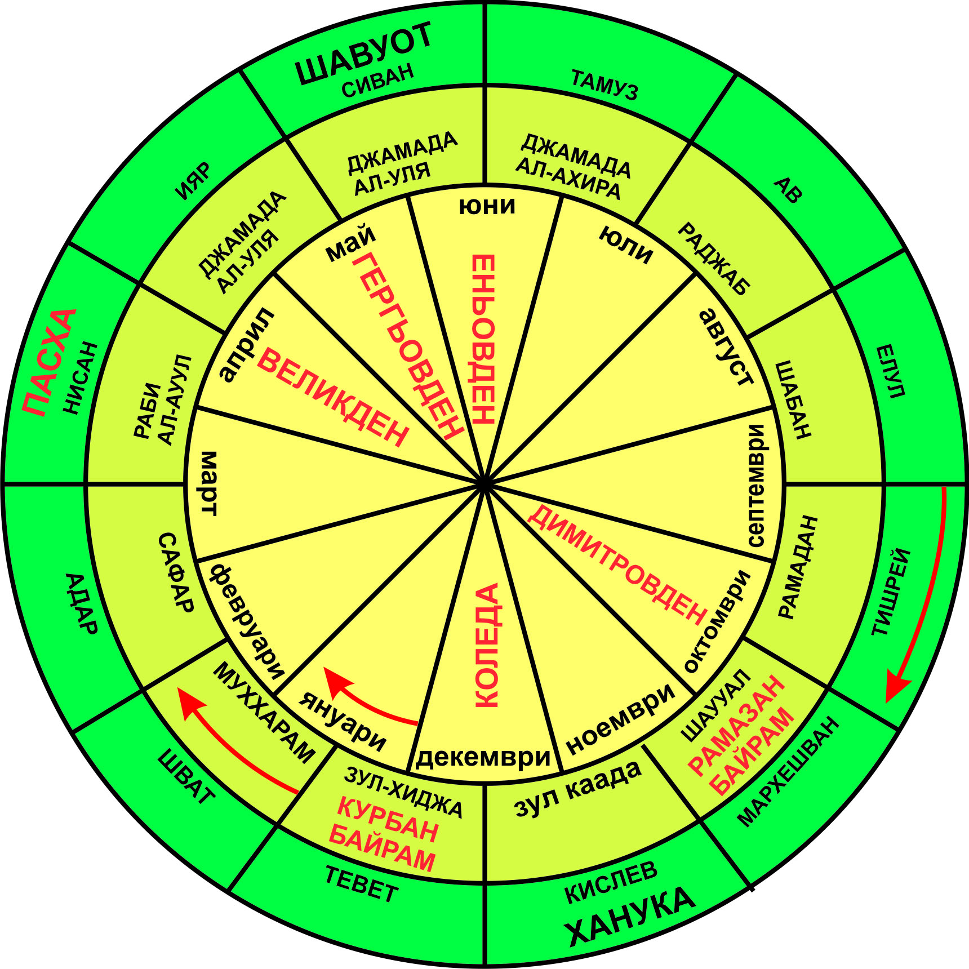
MIDSUMMER
24 th of June

Slide 3
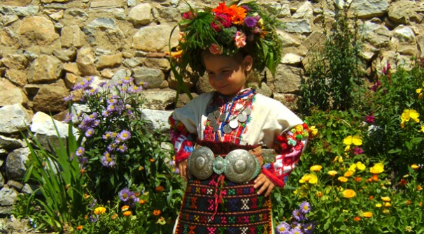
The longest day of the year, the Sun has the greatest force !
24 June is ...
Observations of people show that after this day ‘’ the sun turns to winter ‘’

Slide 4
Basic custom associated with the holiday’s …
PICKING UP of Herbs to WHICH BELIEVES THAT THEN THEY ARE THE MOST EFFECTIVE

Slide 5
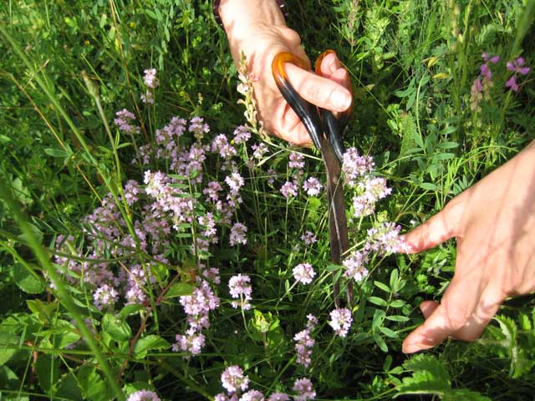
Herbs in the crown must be 77 and half as there are diseases. There is a cure for 77 diseases and only for half disease there is not. And that it is half an herb that some people know how to find it.

Slide 6
Midsummer bride
5-6 year old dressed as a bride, with a long white shirt and a red coat. They veil her with a red veil. On his head and put a silver coin wreath of lady’s bedstraw. A girl raises Enyo bride on their shoulders and the whole procession began to circle the village, fields, gardens, wells and fountains. All the time girls sing song. With this ritual they want to beg from St. Enyo health and fertility.

Slide 7
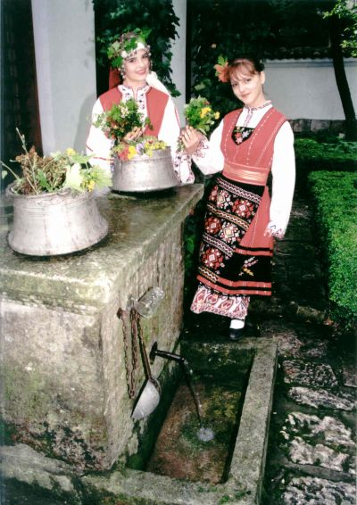
Groups girls put their wrists in a white jug under a rose bush at night to see them caress stars. On the next day Enyo bride pick out one by one wrist, this time the girls sing, as called for what man will marry a girl concerned. Finally, the girls washed the face of the bride Into water from the jug, put her with a new outfit and after that they return her to her mother.

Slide 8
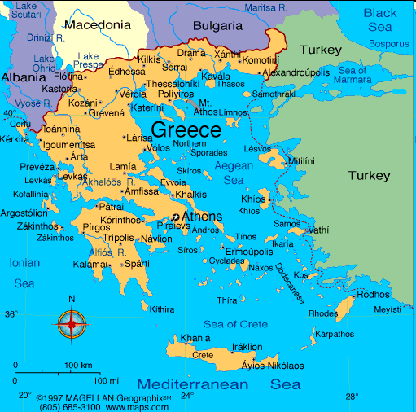
Do you know that .. ?
Greeks revere this day as a celebration of Midsummer called ST. YANI.

Slide 9
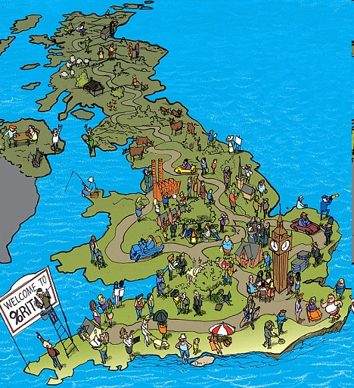
One of the famous comedy by William Shakespeare - "MIDSUMMER NIGHT'S DREAM" (1594), presents events that happen on the night of Midsummer. English name Midsummer's MIDSUMMER (Literally - the middle of summer).
We prepare some posters for traditions and customs in different religions.

Slide 10
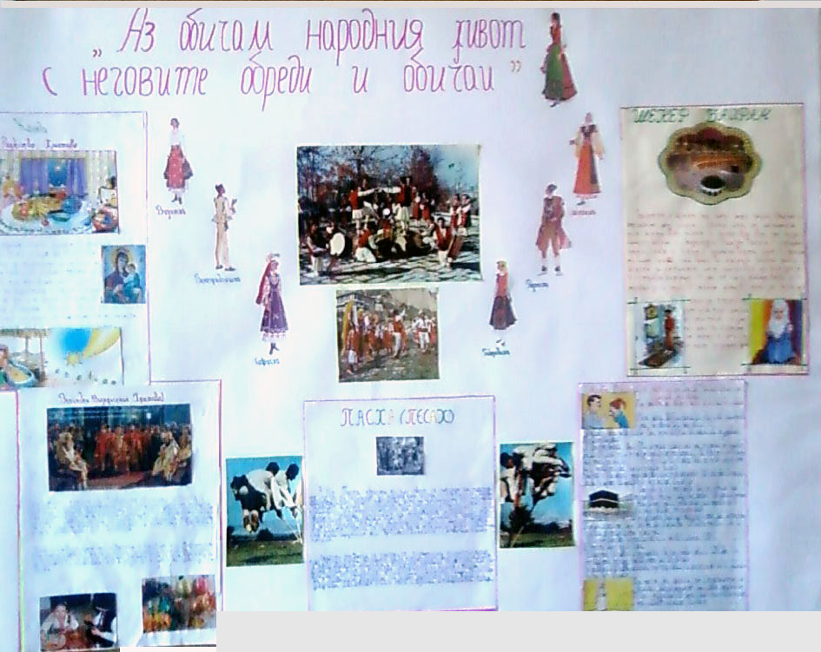

Slide 11
“ Everyone has a right, Freedom of thought,
conscience
and religion !"
CONVENTION FOR THE PROTECTION OF HUMAN RIGHTS

