Slide 2
Project to ACES-”Young volunteers- bridge between generations”
We had interesting meetings, traveling and
exciting experience together with Romanian school from Sibiu.

Slide 3
Project:

Slide 4
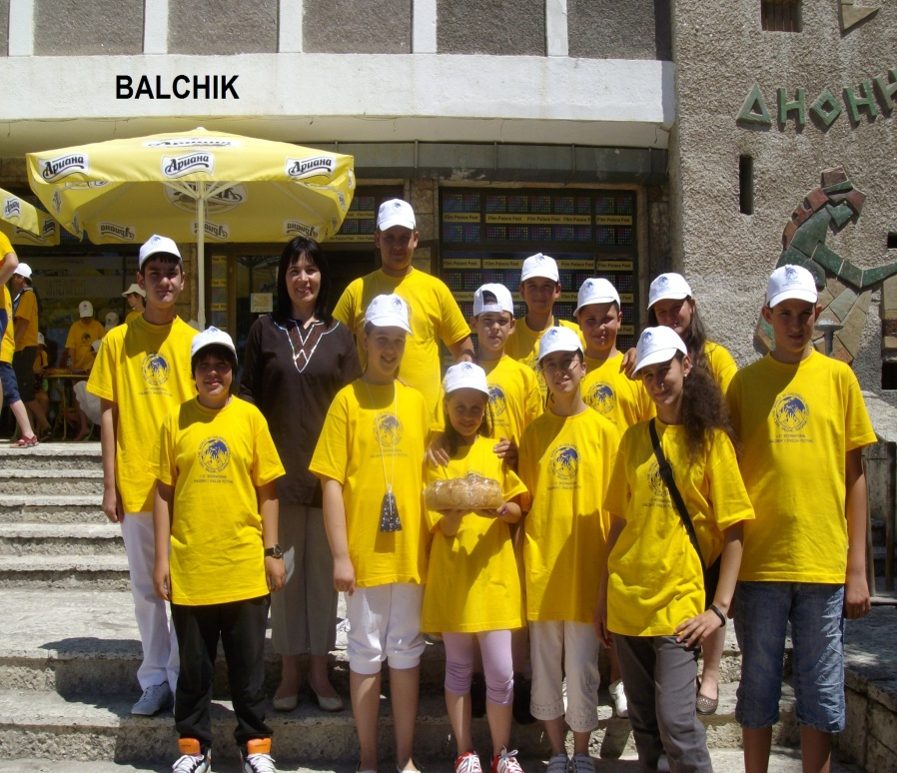
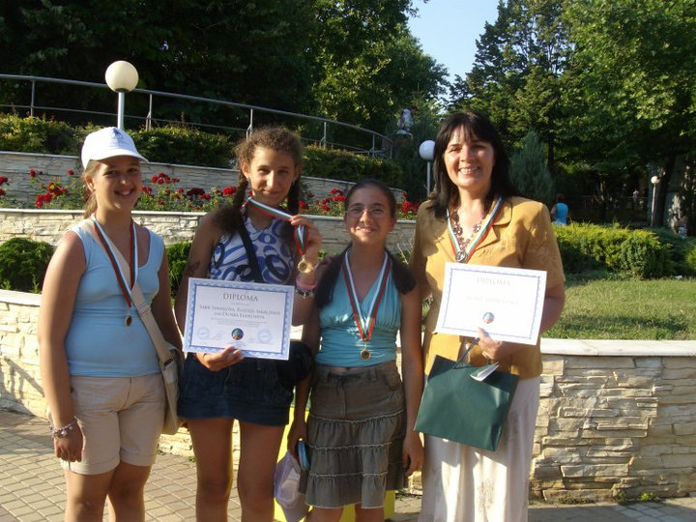
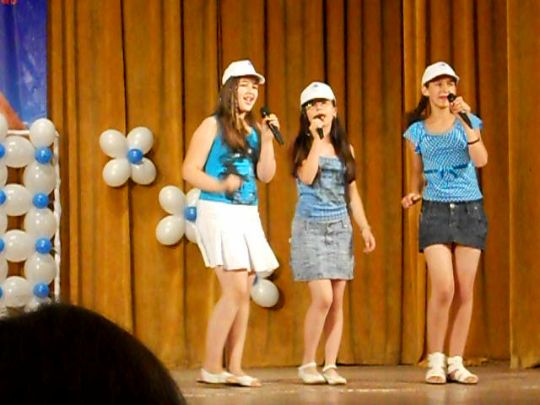
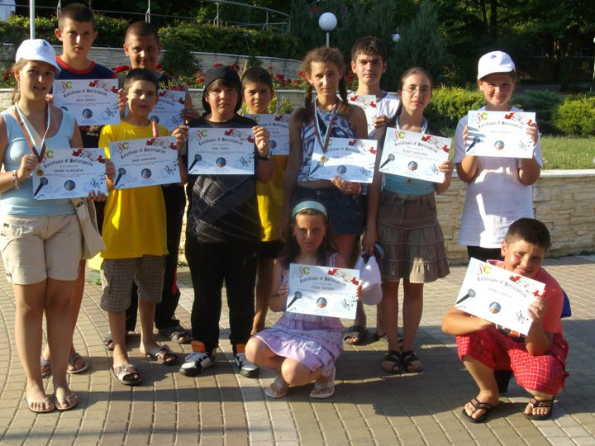
By participating in the First International Festival of English-”World in children’s hands" they understand that they are worthy rivals of their peers from Bulgaria and Europe.

Slide 5
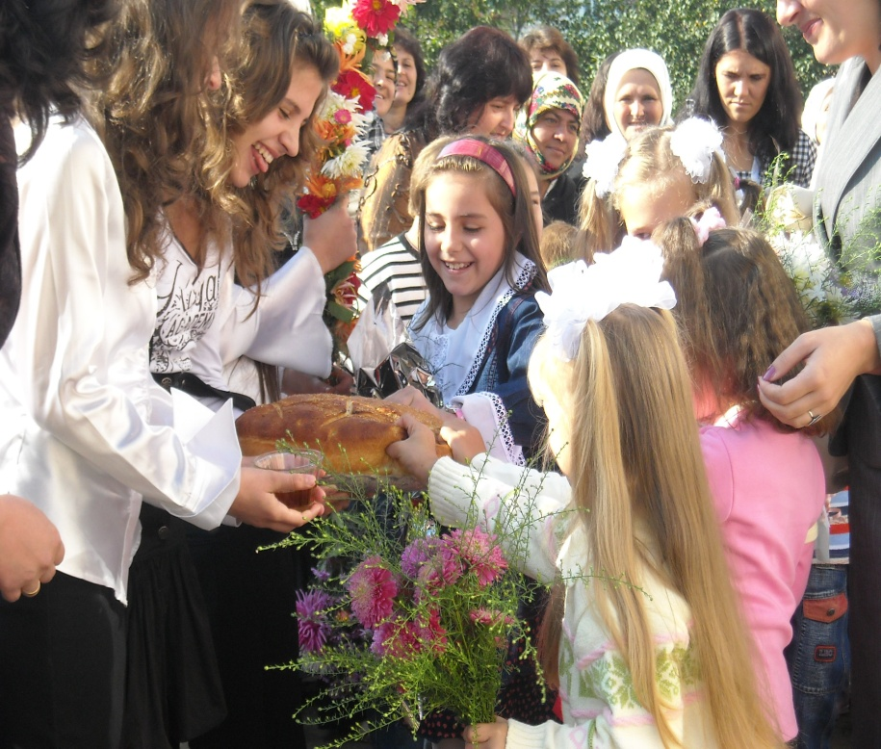
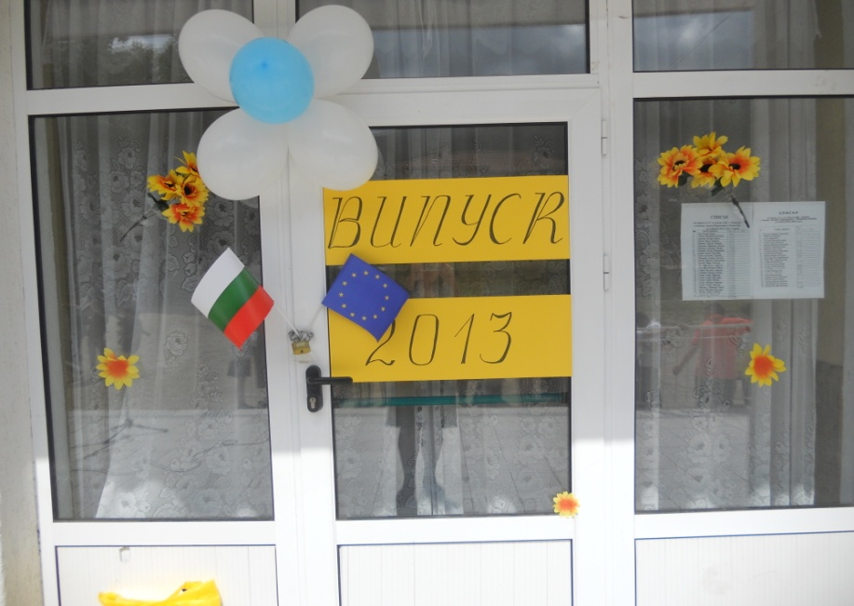
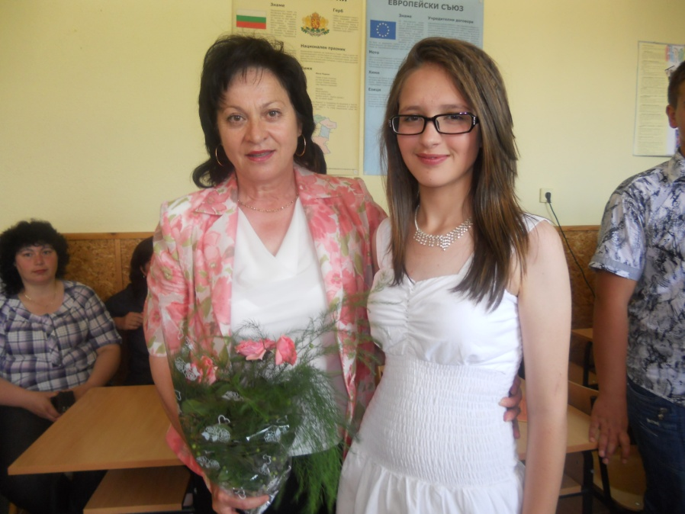
For the holidays
15th of September-
School again!
15th of June-the end of school year

Slide 6
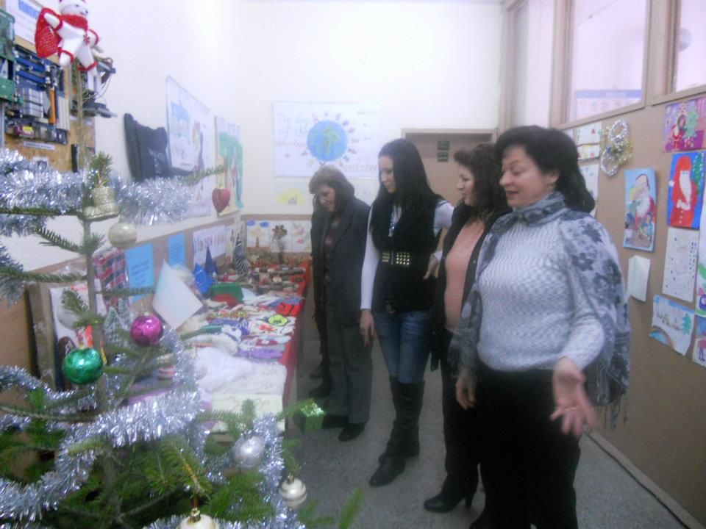
Christmas and New Year

Slide 7
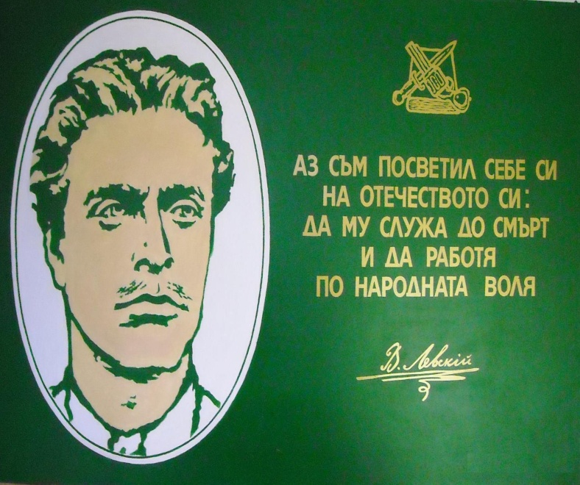
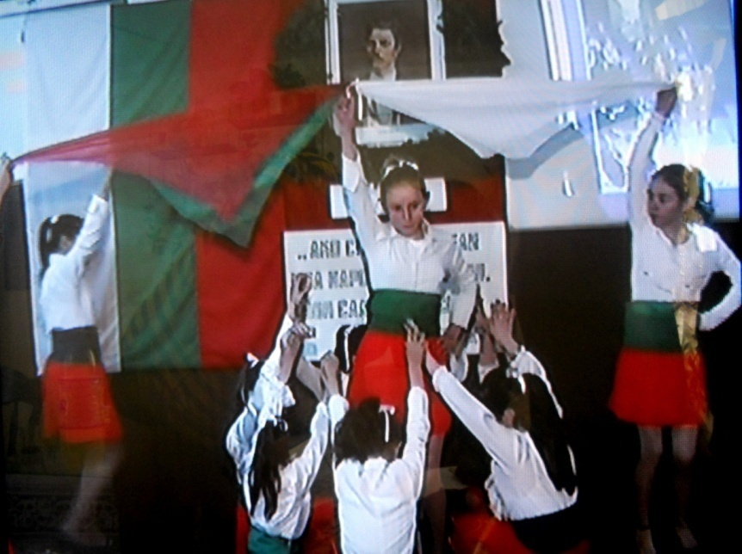
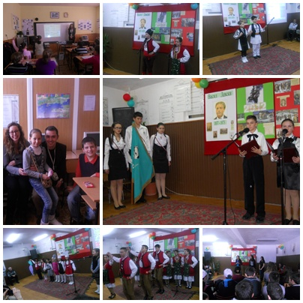
Patronal feast of the school

Slide 8
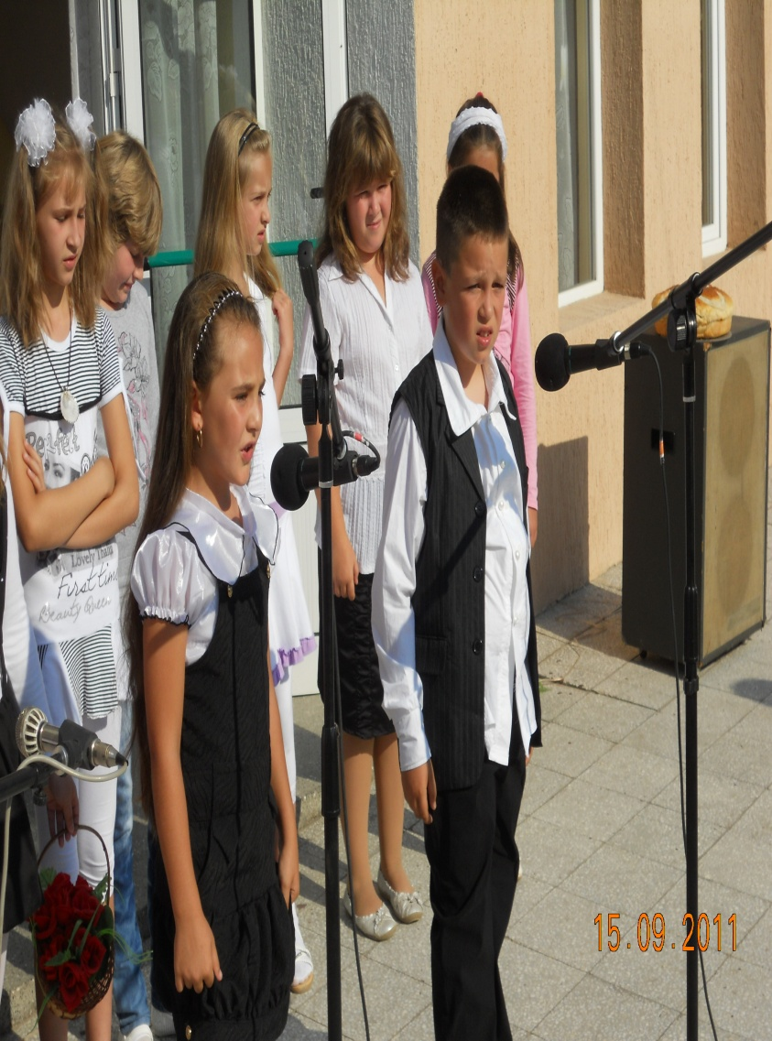
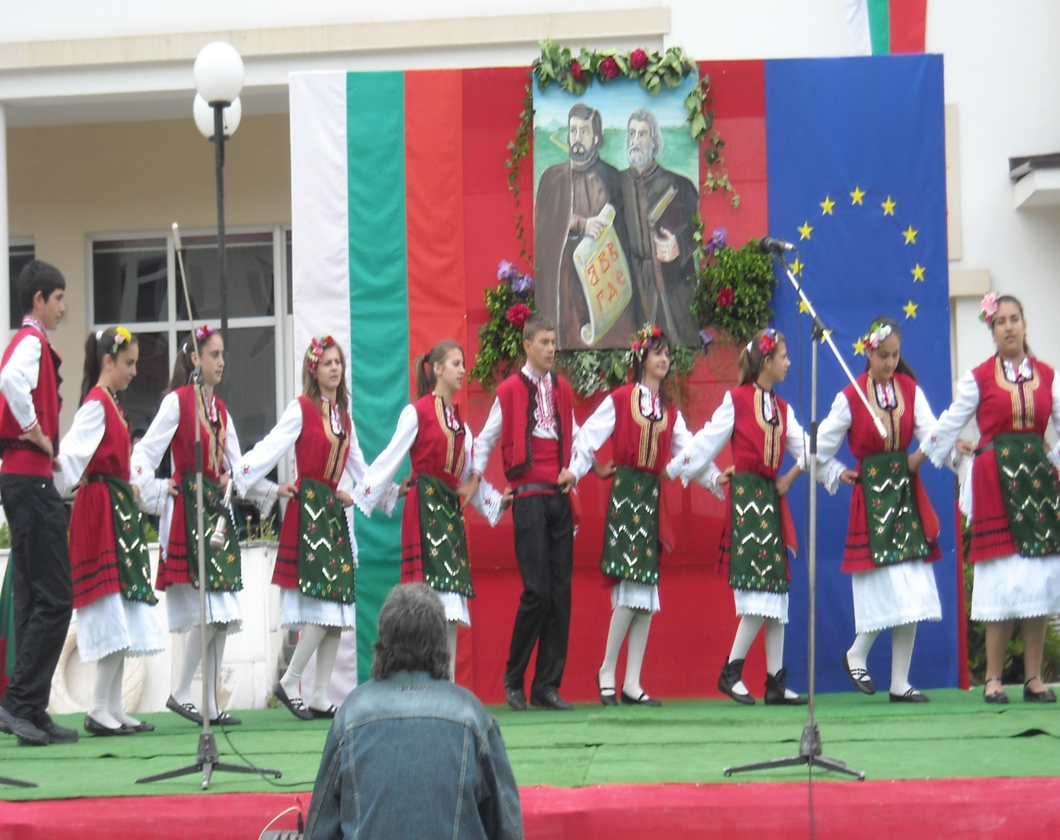
Especially for the day of "Slavonic Alphabet and Bulgarian Alphabet and Culture -May 24th

Slide 9
European days - May 9th and September 26th

Slide 10
That we are -
small people
from a small
school in a small
village,
people with big
ideas, those who
stand
under the slogan:
If YOU SUCCEED HERE -
YOU CAN DO IT ANYWHERE!

Slide 11
Can we be part of Europe's large family?
Together with YOU
we have set the following
objectives to accomplish the
Project:
“I love my future as an European citizen"

Slide 12
THANK YOU!

