Slide 1
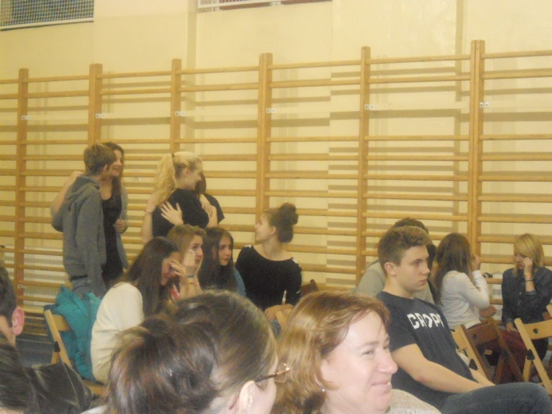
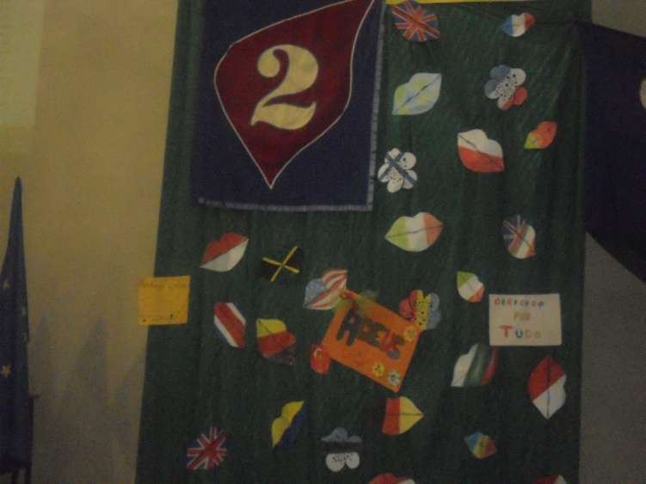
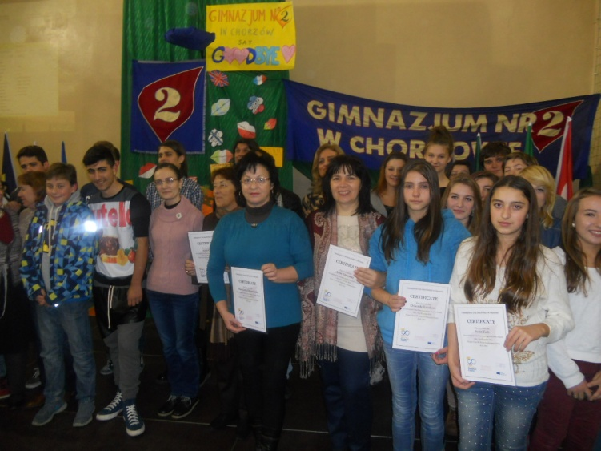
Friendship

Slide 2
EXCITING EXPERIENCE
The first exciting experience in my life!!! For first time I have been in abroad - without my parents. We had to travel with our teachers and our mates.
We met many friends and we got new knowledge about life, history, nature and culture of Poland, language skills and so on.
I have never had so interesting, joyful and funny moments!
Thanks to Comenius Program- it gave me a chance to have
these moments!

Slide 3
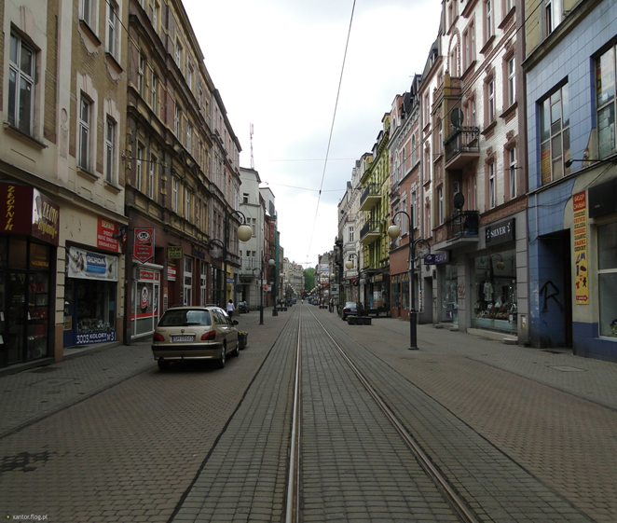
I think Poland is a very beautiful country. We saw different sights.
When we were in Poland it was really nice. Even before we knew students from Poland because they visited Bulgaria in September. We communicated with them via social networks.

Slide 4
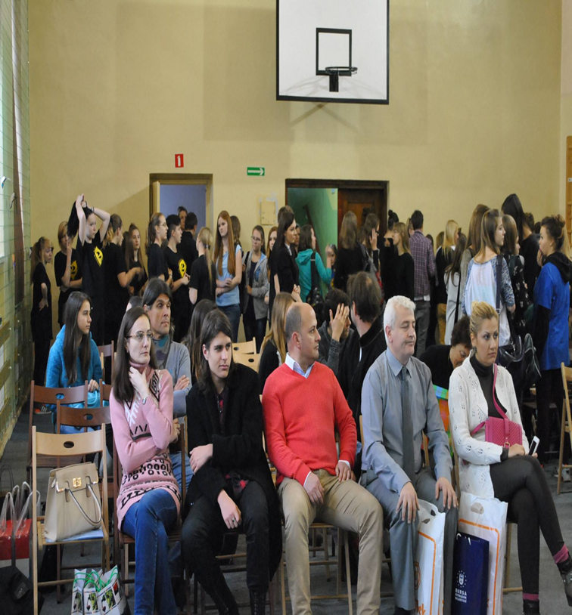
There were students and teachers from Italy, France, Portugal, Romania, Bulgaria and Turkey.

Slide 5
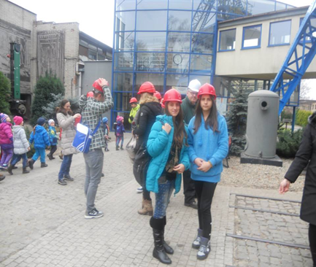
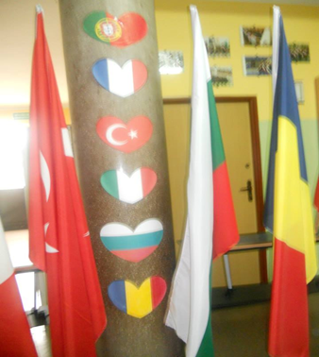
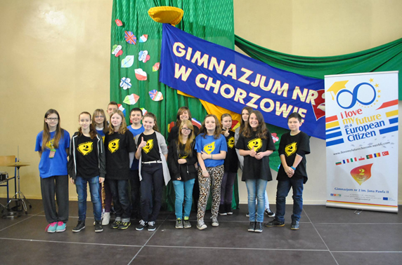

Slide 6
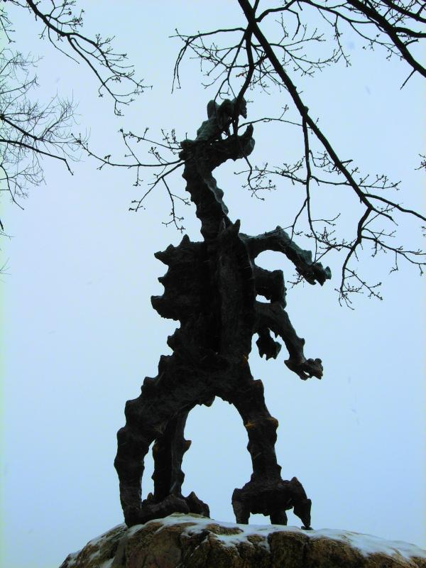
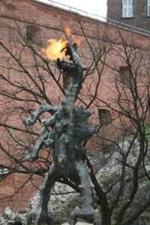
We visited Krakow on Wednesday. We saw very important sights.
Wawel Cathedral and Kraków's Wawel Castle stand on Wawel Hill. The cathedral features a statue of the Wawel dragon and a plaque commemorating his defeat by Krakus, a Polish prince who, according to the plaque, founded the city and his palace over the slain dragon's lair. The dragon's cave below the castle is now a popular tourist stop.

Slide 7
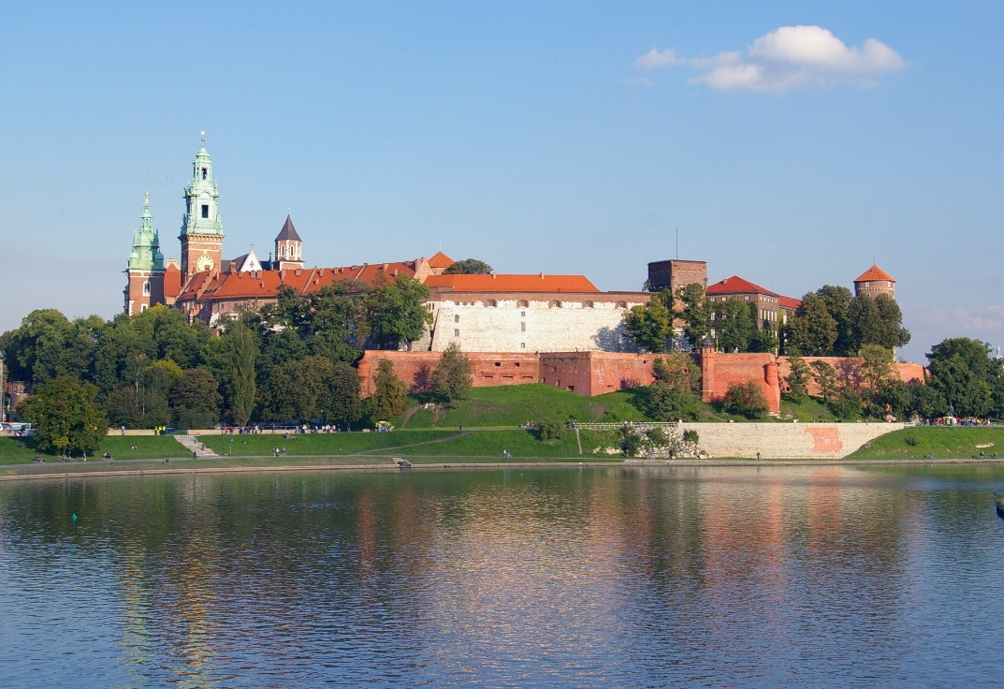
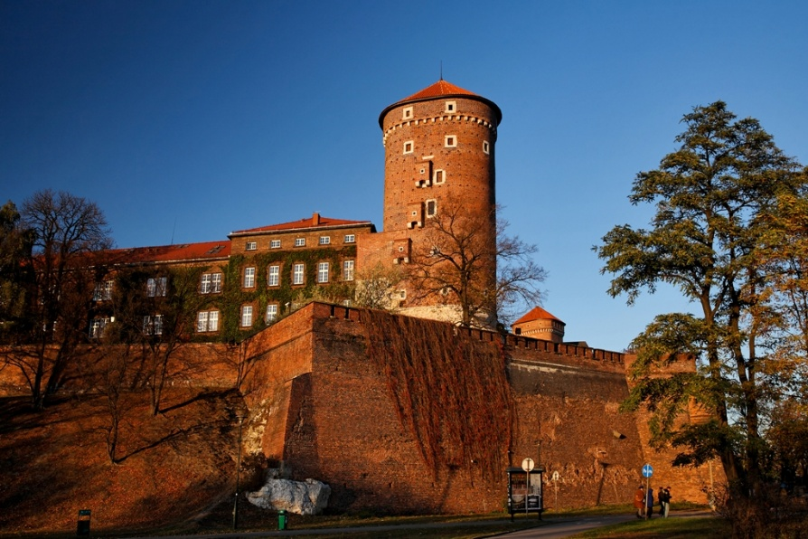
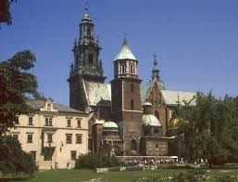
We visited famous and beautiful castles. Wawel is a limestone hill in the centre of Krakow upon the Vistula River with a complex of impressive historical monuments of unique historical and artistic values. This extraordinary sanctuary determines the Poles’ identity, is their national and cultural symbol.

Slide 8
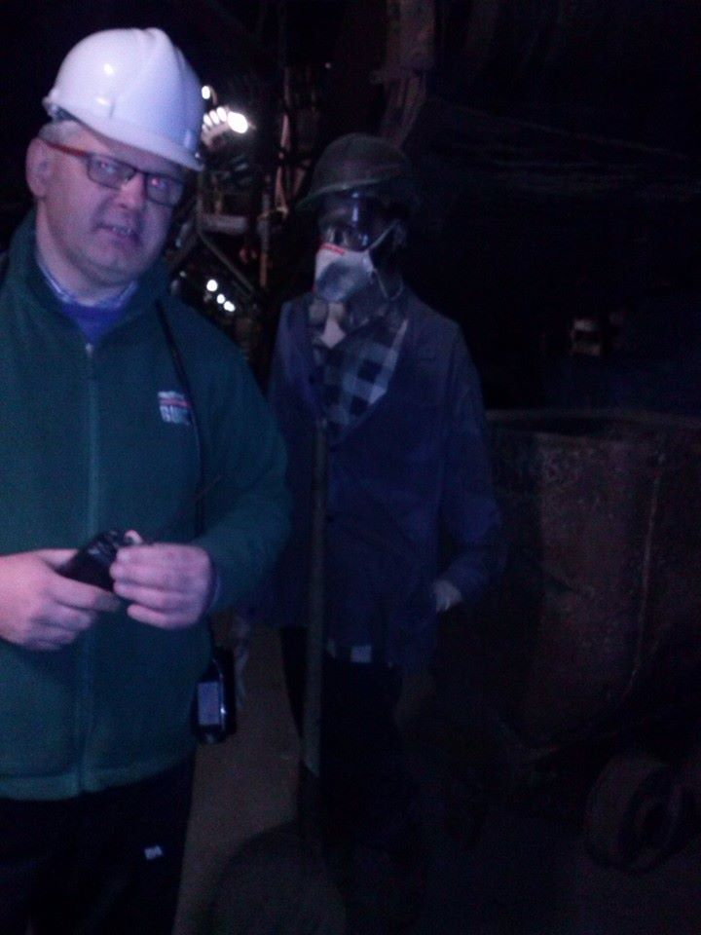
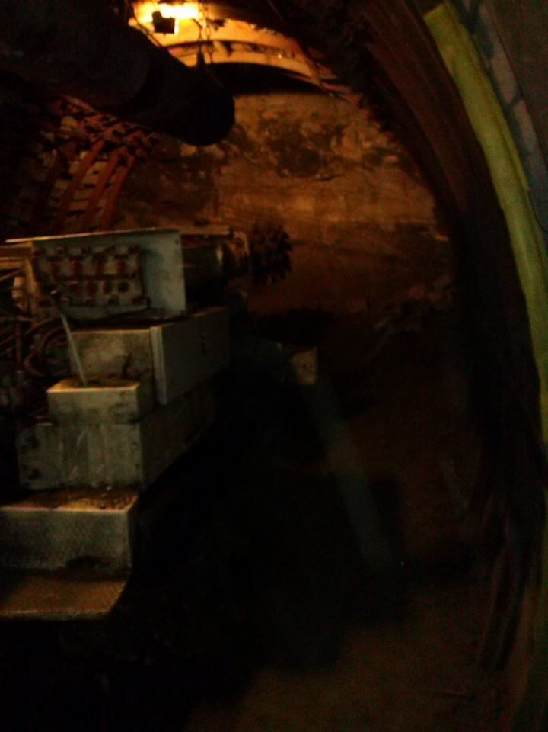
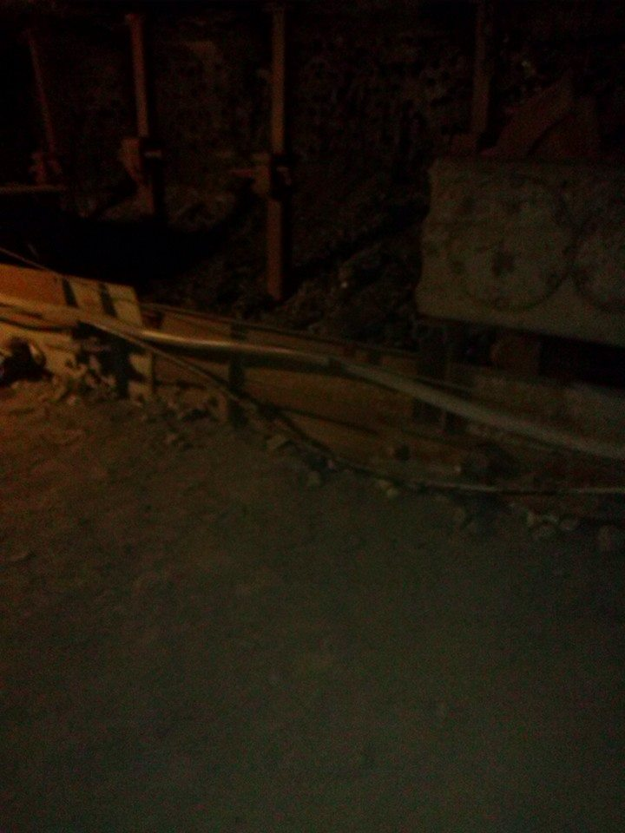
We visited mine, which is under Italian Bank. Nowadays this mine is national Museum. We had to wearing helmets. We were 320 meters below ground. We went with elevator to the ground. In the mine there were minerals and realized that thanks to our tour guide.

Slide 9
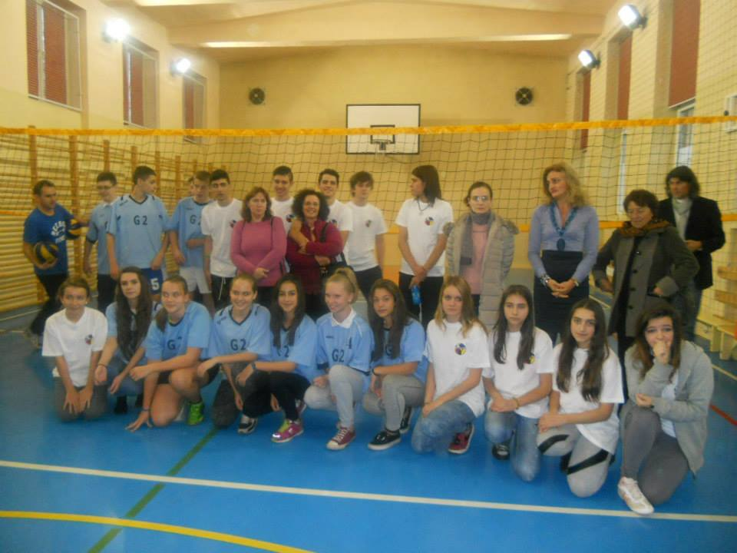
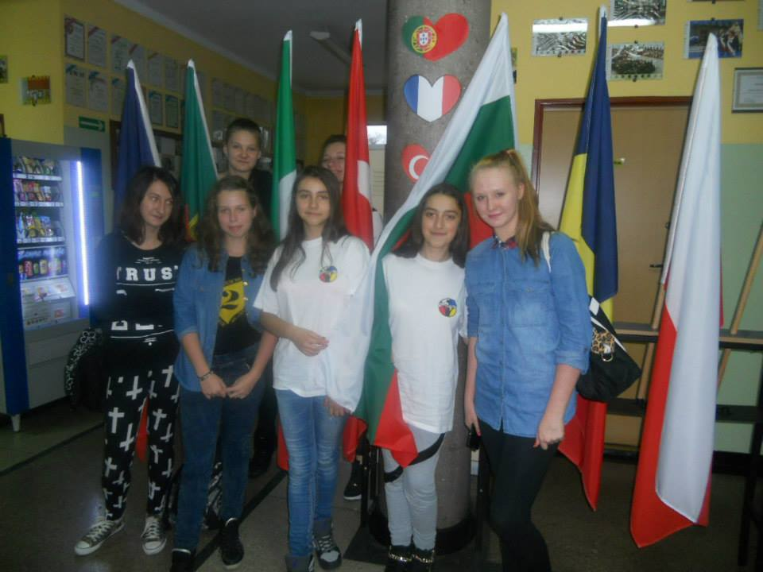
In the school we met with many students. Also we like school, students, classrooms and teachers. We played volleyball and basketball with all students. We like everything in Poland.

Slide 10
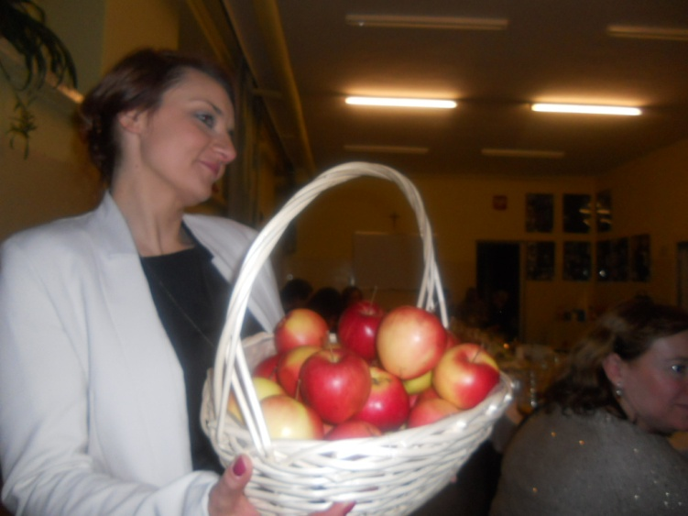
At the end- thanks to Polish families- hosted us all the time! We will never forget!

